Slide 1
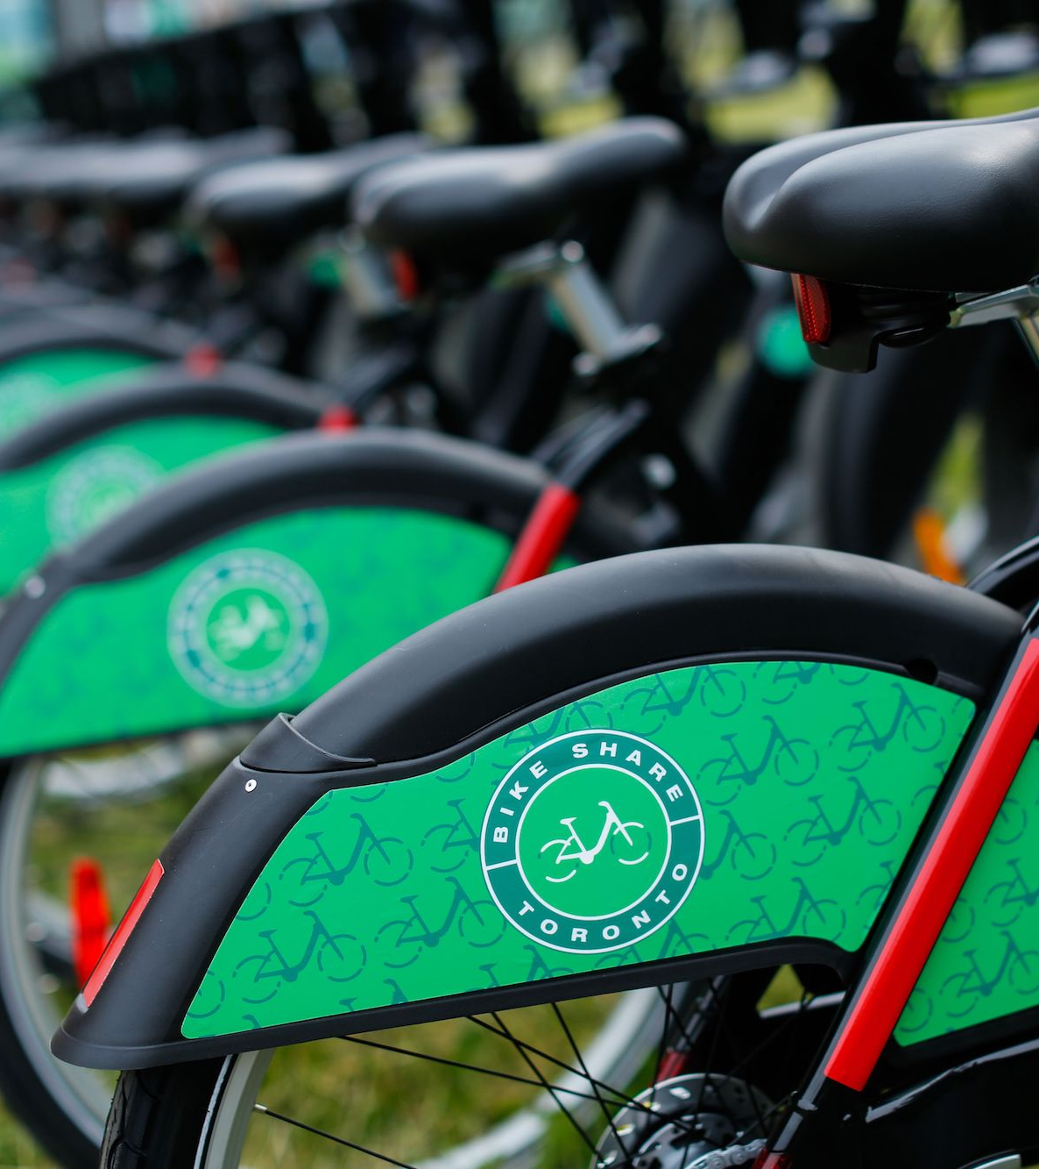
Toronto Bike Share Analysis
GROUP MEMBERS:
CARLY YIAO
GUSTAVO PIRES
RICHARD GU
TINA SARAVI
VARUN VINODH
Notes:
We encourage our audience to interact with our project deployed to Github for a more interactive experience.
The url has been provided on the slack channel

Slide 2

Project Overview
Bike Share Toronto is a bike-sharing system that has been expanding since 2011.
It launched a 4-year growth plan in 2022, aiming to have at least 1,000 stations and 10,000 bikes by 2025.
The aim of our project is to investigate the status quo of ridership after the first year of its implementation.
Notes:
More specifically:
Did ridership in 2022 follow historic trend or did it deviate in any way?
How can the trends inform the growth of the program in the upcoming years?

Slide 3

Data Exploration
Bikeshare Station API
Live information on the bike stations
Ridership Bike Share Toronto API
Historical data for trips made within the system
2021 as basis of comparison
More than 8 million records for the study
Notes:
For the purpose of our study we extracted data from 2 different open source APIs:
Bikeshare station API: Live information about every station
Ridership BikeShare API: historical data from 2014 onward,
Because of the rapidly expanding bike share network year after year, we’ve decided to use the 2021 data as the basis of comparison for ridership in 2022.
This led us to more than 8 MM records

Slide 4

Key Features
User Type
Member or casual
Start and end time
Trip Count and Trip Duration
Start and End Station
Cross reference coordinates from the station API
Notes:
We’ve narrowed the scope of our study to the following key features in the ridership datasets.
User type: Annual members or casual users
Start and End Time: for trip count and trip duration information
Start and End Station: for geospatial visualization
Since one of the key planning objectives for the four-year growth plan is about the generated revenue, which is directly related to the type of user using the system, we were required to perform investigation about local demand and ridership of both these user groups during the network expansion.
Let's think about this: Who’s riding the bike? How they are using the system? Where, when, and duration.

Slide 5

Approach
ETL (done in python and pandas)
Cleaning, aggregation, and organization of summary data
NoSQL (mongoDB) for storing and querying unstructured data
Interactive Plotly plots for summary data
Geospatial visualization using Leaflet
Notes:
Due to the sheer volume of data, our approach was to build a pipeline in order to clean, aggregate and organize multi year datasets.
The pipeline was completed using the pandas library in python.
Due to the unstructured nature of the summary data, we used a NoSQL database (MongoDB) to store our data and connect to our Flask app.
We visualized our datasets with Plotly and a new Javascript library and projected our data onto an open map using two different Leaflet plugins.
Now I will pass it over to Tina to talk about our Analysis

Slide 6
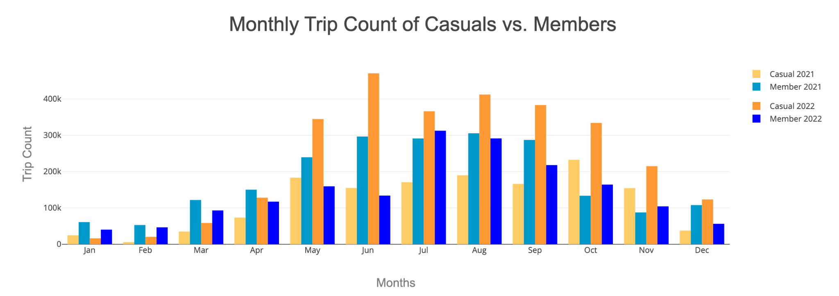
Analysis - Monthly Trip Count
2022 saw in increase of 101% of casual riders, while there was decrease of 18.6% in member riders
The trips taken in both years peaks in the summer months June-July
Notes:
In order to gain a better understanding of our dataset, we decided to plot the amount of trips taken and their duration by casual and membership riders in three different time intervals for the years 2021 and 2022. The three time intervals that we believed would give us the best understanding of riders behaviors was a monthly, daily, and hourly basis.
Looking at the first metric that we investigated was the amount of trips taken. Overall, we found that there was an increase of about 101% in casual riders from 2021 to 2022, whereas there was a decrease of about 18.6% in member riders from 2021 to 2022.
The monthly trip count analysis showed that the highest number of riders in both years occurs during the summertime. The highest peak for casual riders occurs June of 2022(click), while in 2021 the highest peak for casual riders occurs in October(click). The highest peak for member riders occurs in July of 2022 (click)but (click) the highest number of trips taken by members in 2021 occurs in August.

Slide 7
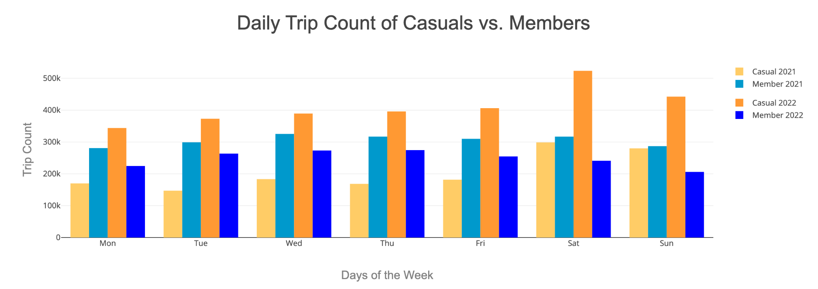
Analysis - Daily Trip Count
Casual riders trip peaks on the weekends
Member riders trip stays consistent throughout the week
Notes:
Looking at the daily trip count data, the data indicates to us that more trips are taken (click) by casual riders on the weekends while members' ridership (click) stays fairly consistent throughout the week in both years.

Slide 8
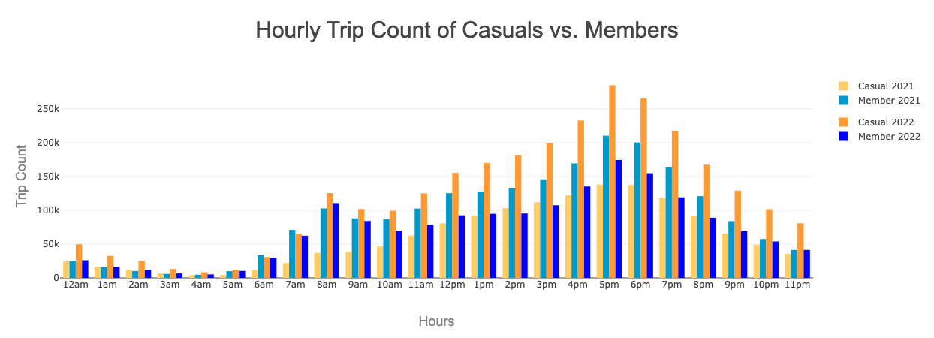
Analysis - Hourly Trip Count
A sharp increase in ridership occurs during the evening rush hour
In 2022 more casual riders opted in to bike to work
Ridership peaks during rush hours
Notes:
The last time interval looked at is the hourly trip count. The data shows spikes in the amount of trips taken by both members and casual riders in the hours of the day that correspond to rush hour(click). Indicating that ridership increases for commuters going home from work. Between 2021 to 2022, there is a sheer increase in casual riders during the morning commute hours(click). This also strongly indicates that more morning commuters are opting in to biking to work.

Slide 9
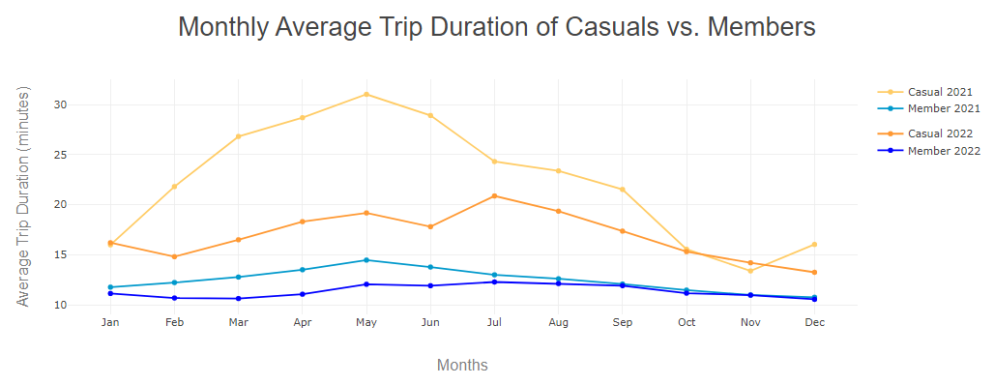
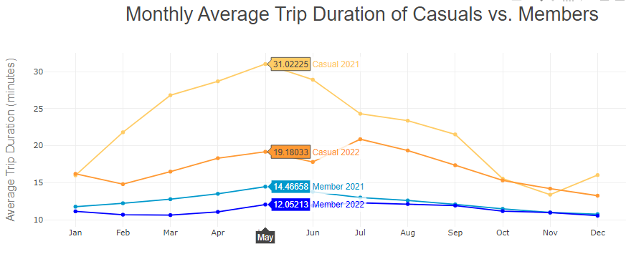
Analysis - Average Monthly Duration
Decrease in average trip duration from 2021 to 2022 for each user category
Increase in warmer months
Notes:
Thank you to Tina for talking about the total trip counts, now I will talk about the average trip durations for months, days of the week, and hours of the day. (click) The monthly average trip durations shows an increase in the warmer months throughout March to August of 2021 for both casuals and membership riders.
Focusing on the light blue and blue lines, Member riders in 2021 and 2022 were very similar in monthly average trips. Whereas, Casual members varied drastically especially in the February to September months. There was more significant decrease for casual riders, as evidenced by the larger gaps between the orange lines. (next slide)

Slide 10
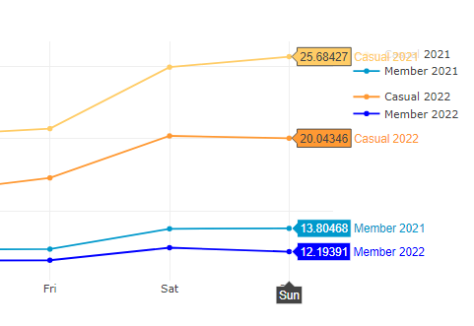
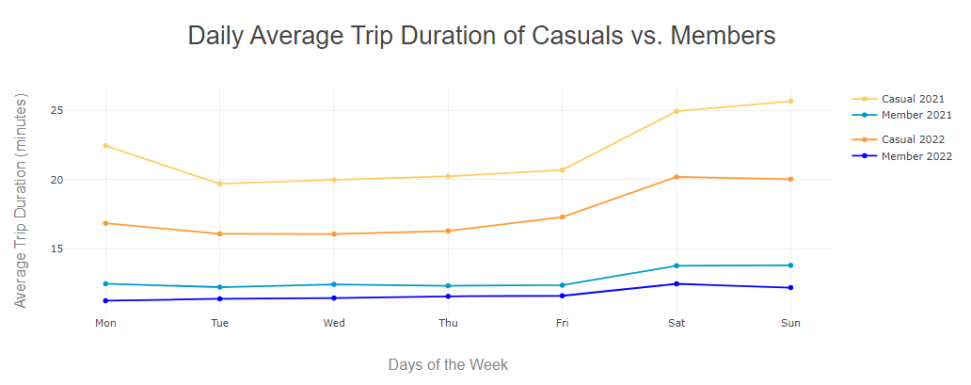
Analysis - Average Daily Duration
Peak times were the weekends
Increase of riders on Mondays for Casual riders
Factors affecting the months could be free time, traffic, and work schedules
Notes:
Daily average durations have parallel lines meaning no intersection of data and overall similar patterns for each day. (click) Throughout the days of the week, peak times were the weekends with 25 minute usage and low times were Tuesday to Friday. (next slide)

Slide 11
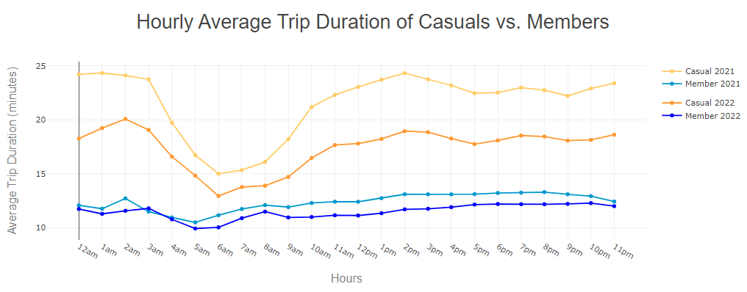
Analysis - Average Hourly Duration
Massive peaks and dips for the casual riders
Casual bikers dip during 4am-9am
Member riders want best for their money
Trip durations in 2021 higher than 2022
Notes:
Lastly, hourly trip durations have massive peaks and dips for the casual bike riders compared to the members being more stable. (click) Casual bikers dip during the 4am-9am times of 12 minutes and peaks during the 2 pm and 1am hours of 12 minutes.
Overall, there was a decrease by 8.6% for members and decrease of 21% for casual riders from 2021 to 2022. (next slide)

Slide 12
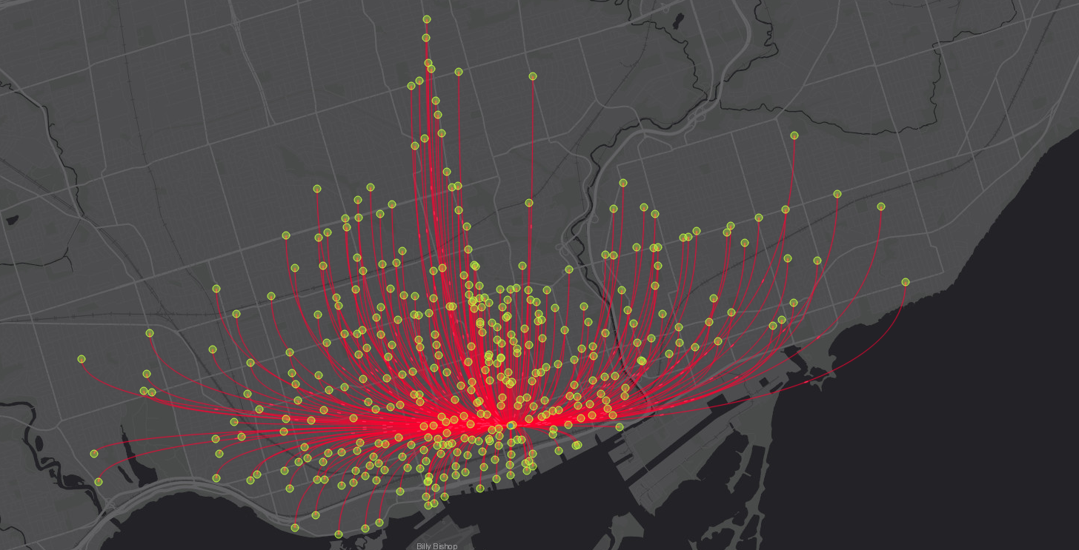
Leaflet Visualization
https://skullfort.github.io/bst-demo
Notes:
We have projected feature data onto an open map for the Toronto region to gain more insight into the rise in casual riders and the decrease in their trip duration from a geospatial perspective.
On the first layer, you can select the stations in service in 2021 (shown as red) and additions in 2022 (shown as green) to view the expansion of the bike share system from one year to the next. Each popup bound to the bike icon shows the station id and address.
On the second layer, we have calculated, for each station, the percentage of trips starting there made by casual riders each year. Here is what the distribution looks like for 2021, and the legend for it can be found in the bottom left corner of the map. The radius of each circle is proportional to the total number of trips started at the station, which can be found in the popup. Therefore, the larger the circle and the darker its shade, the more casual trips there were. Note the prominence of casual trips along the lake shore and the dominance of membership trips in the downtown core in 2021.
If we select the same metric for 2022, we can see that the percentage of casual trips increased across the system as opposed to being localized, indicated by darker circles across the map. Considering the size of the circles, we further observe that there was a significant rise in the number of casual trips in the downtown core, which can be attributed to the post-pandemic recovery of downtown economy.
To understand this shift in user composition more, we’ve projected the average duration of casual trips from each station during a summer month onto another layer. Once again, the size of each circle corresponds to the number of casual trips made from each station, the information for which can be found in each circle’s popup. The color, on the other hand, corresponds to the average trip duration. The brighter the color, the longer the trip. Bearing in mind the color distribution and size of circles in 2021, we now select the same metric for 2022. Note the significant size increase yet darker shader in the downtown core.
Because downtown is historically dominated by membership riders, who make shorter trips, it can be tied in with the shorter durations of casual trips in 2022. With the prevalence of hybrid work in sectors such as finance, tech, and professional services in downtown Toronto, the same riders that used to subscribe to annual memberships no longer needed to commute as frequently. The duration of their trip had not changed, but they had become what the system categorized as casual riders, resulting in an overall drop in memberships as well as an overall decrease in average casual trip duration.
There is one more feature we’d like to show. To see where the bike traffic could come from within the system during morning peak hour, which saw similar trip counts in 2022, we added a flow map. The arrows that point to the busiest bike station during peak hour come from origins in the central bike share system, excluding most of the new additions in 2022, but this could change as the system gets more coverage in the coming years.

Slide 13

Data Findings
Change on surface: Increased bikes (60+) and bike stations (330+)
Increased activity during summer months
Increase in revenue
Notes:
From our analysis, we find that
The ridership activity exhibits a positive correlation with
seasonal patterns. Summer months from May to Oct see the highest number of
riders during the year, with June 2022 receiving record high ridership numbers.
This is likely due to the pleasant weather during the summer months, which
encourages people to spend more time outdoors and engage in physical activities
such as cycling. In general, weekends see a higher trip duration on
average.
The surge in ridership can be partially attributed to the expansion of bike stations and available bikes, as well as the increase in cycling opportunities in the post-pandemic era. The shift in user composition, with a transition from more membership riders to more casual riders, can be linked to the shift in the workplace paradigm, moving away from regular commute to downtown offices and toward a hybrid work arrangement

Slide 14
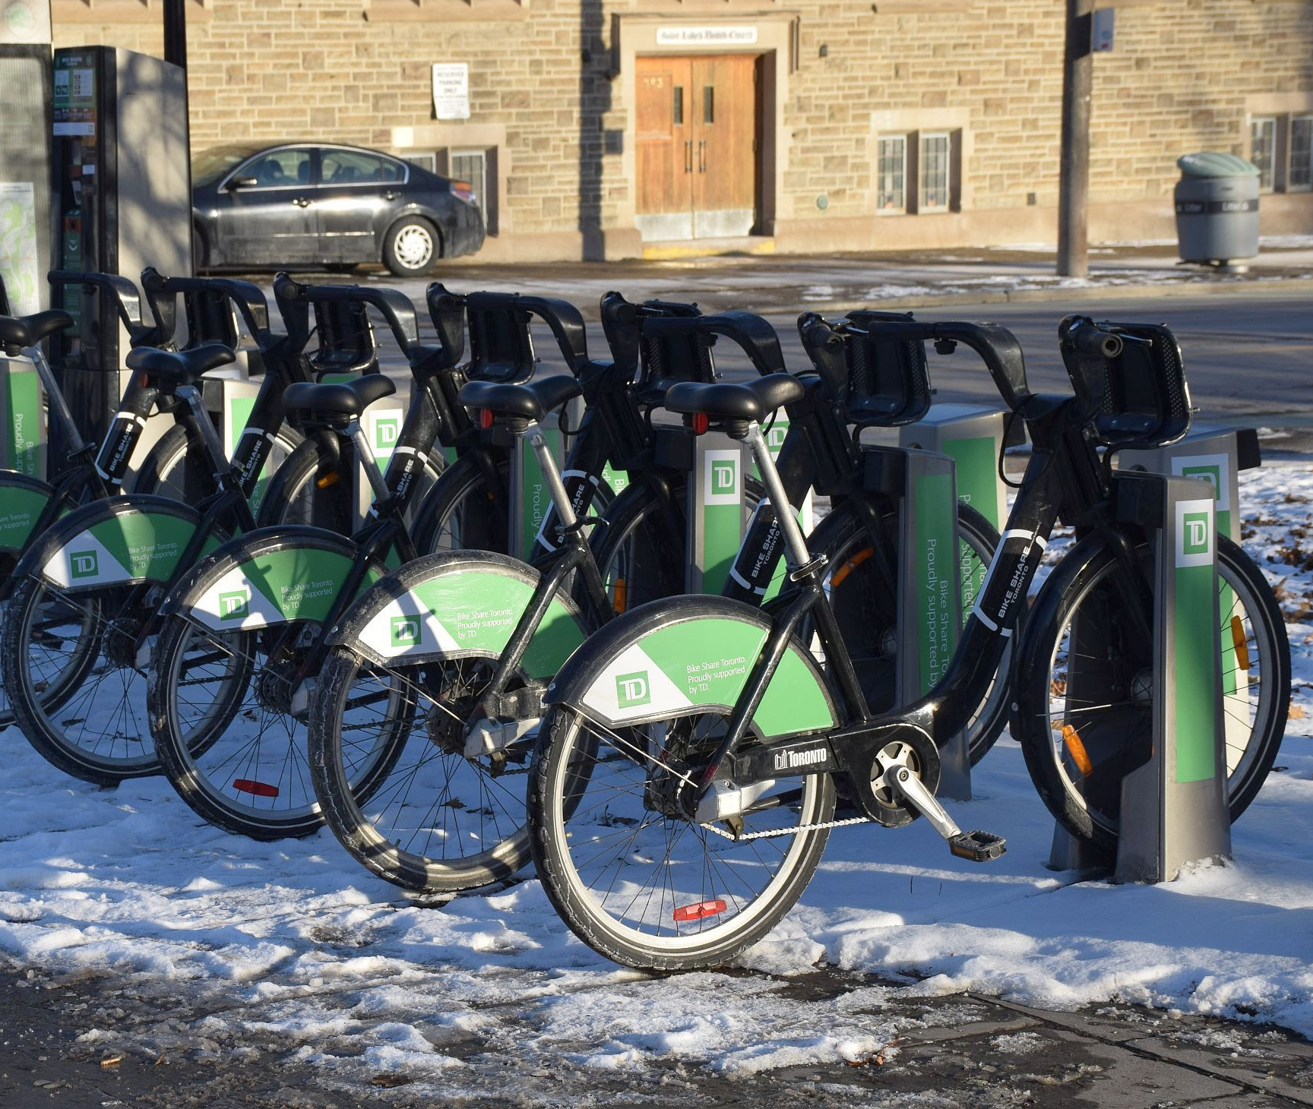
Summary
Decrease in average trip durations for both members & casual riders from 2021 to 2022.
Change in user composition - Casual Members
Change in pricing to cater increased casual members
Notes:
In summary, the bike-sharing program has seen significant growth and changes over the past year.
The increase in casual riders is very good news from a revenue standpoint. Casual riders generate more revenue per ride as compared to members, which has helped to offset the decrease in the memberships
purchased. [Even though there has
been a decrease in trip duration, the increase in casual rider trips has
resulted in an increase in total trip duration and consequently an overall
increase in revenue for the program.
Due to the increase in casual riders, Bike Share Toronto has taken
steps to cater to casual riders when creating a new pricing program i.e., effective
from April 3, 2023). This will allow for shorter distance trips (i.e., <18
mins) to be taken at a lower cost of only ($0.12/min) and will also
remove the need to dock their bikes every 30 minutes as compared to members.

Slide 15
THANK YOU

